Slide 1
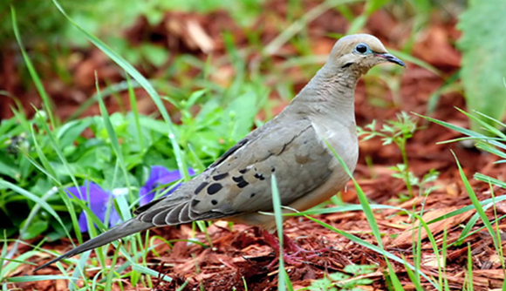
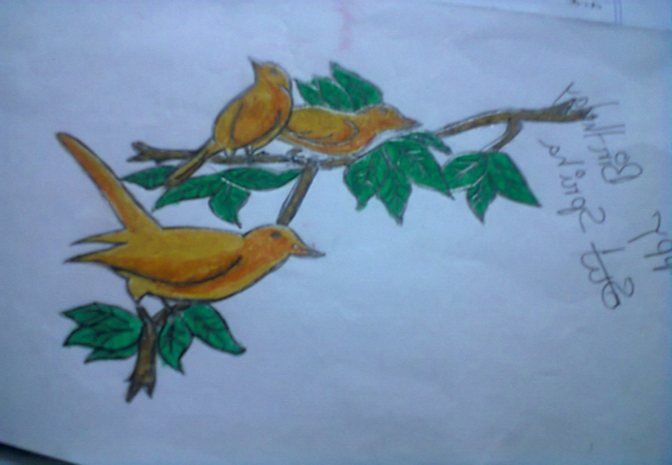
PREPARED
&
PRESENTED
BY
Ismat ara mamataz
Assistant teacher (english)
Dhanmondi govt.
Boys’ high school,
dhaka

Slide 2
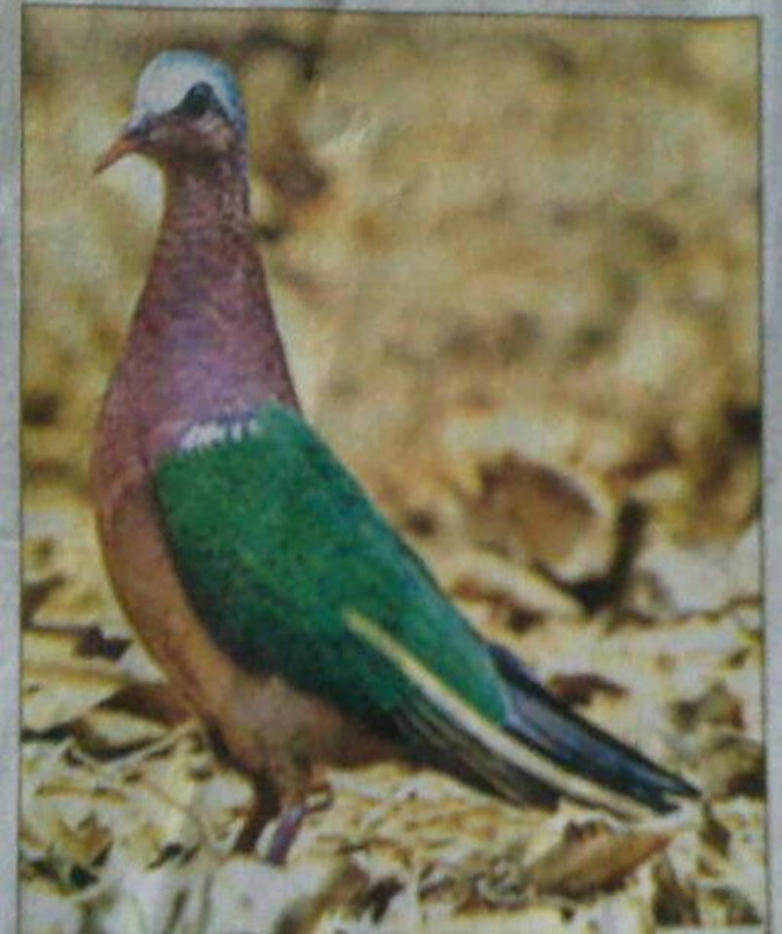
Welcome
to
The English 1st Paper Class
Class viii

Slide 3
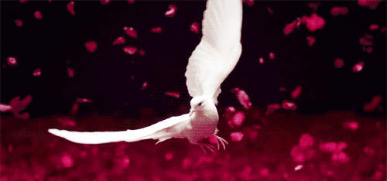
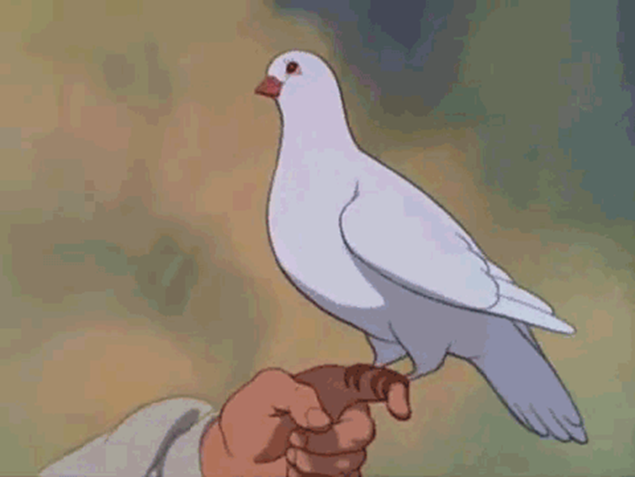
What are you seeing in the pictures?

Slide 4
Today’s
topic
Unit 5
Lesson 6
The truthful dove (2)

Slide 5
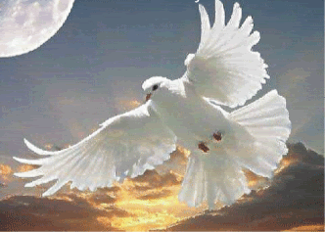
Learning outcomes
By the end of the lesson the learners
will be able to
talk about pictures
describe a situation
ask and answer questions
say/write the statements true or false

Slide 6
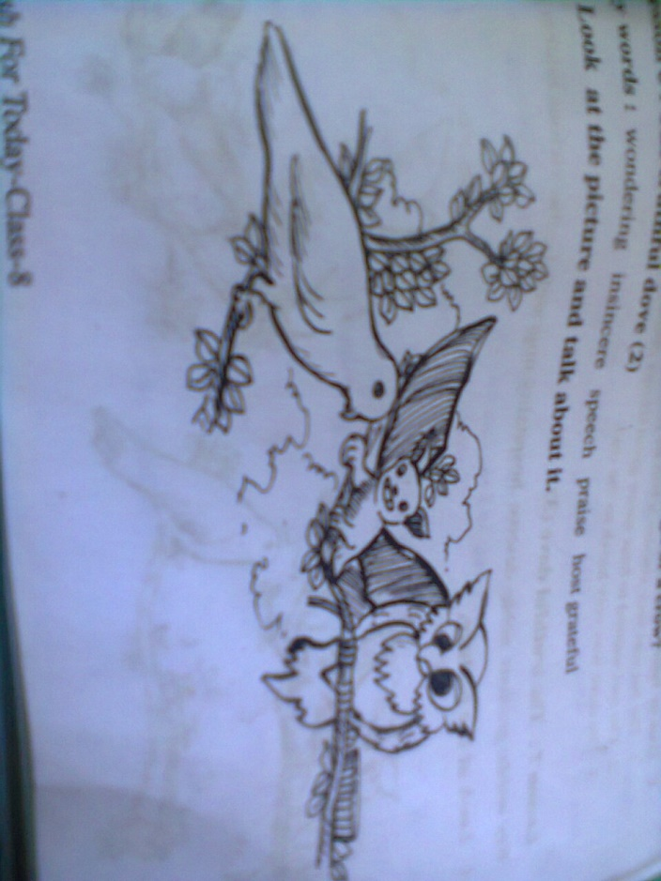
Pair Work: Look at the picture and talk about it
asking and answering the following questions.
1 . What can you see in the picture ?
2 . Guess, what were they doing?
3.What happened to the owl then?

Slide 7
B. Text Reading : the learners will be asked
For reading the text more about the three birds to check their Q /A, and answer the given questions also.

Slide 8
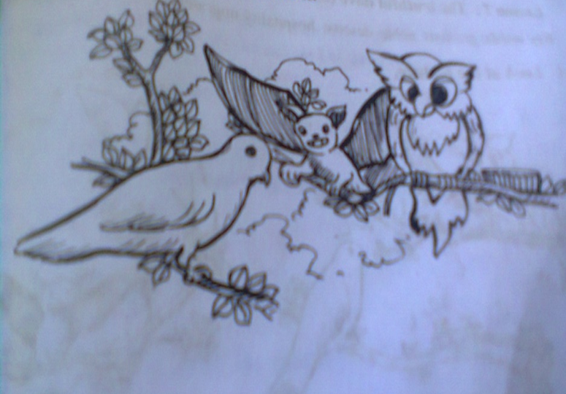
Check your answers.
The dove hung her
head down and
was quiet
The bat was praising
the dove at random.
The owl
got
impatient
All the time the dove was listening to her friend, bat’s false praises. She was getting surprised to hear his untrue praises . The dove hung her head down and remained quiet . At this, the owl lost his patience.

Slide 9
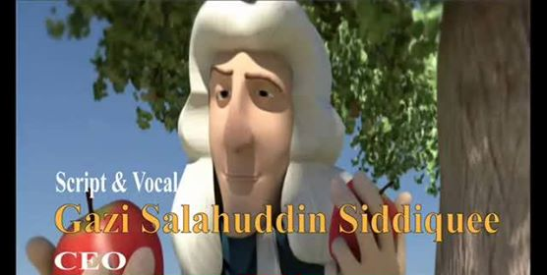
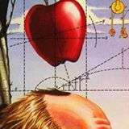
Wondering(adj)
surprising (textual) ,amazing,
inquisitive

Slide 10
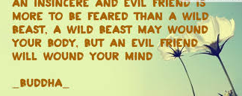
Insincere (adj)
untruthful ,untrue , false (textual)

Slide 11
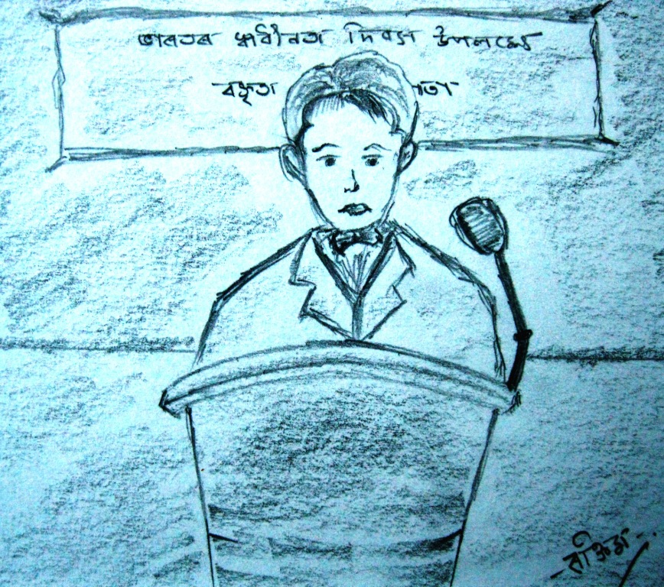
Speech
Speaking, dialogue, utterance

Slide 12
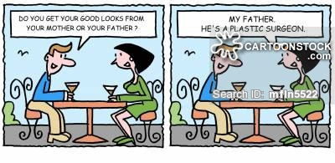
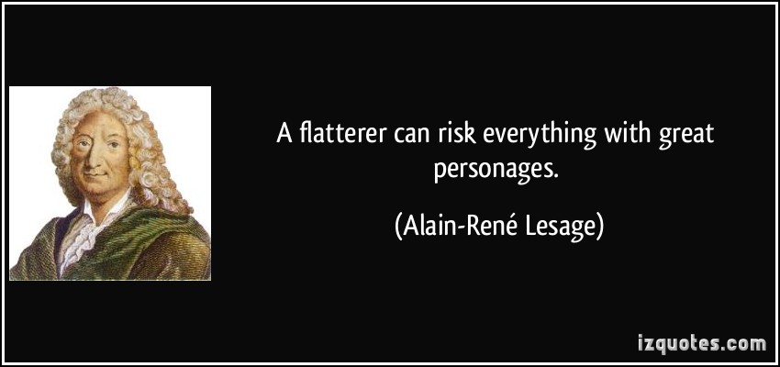
Praise(verb)
admire, cheer, flatter (textual)

Slide 13
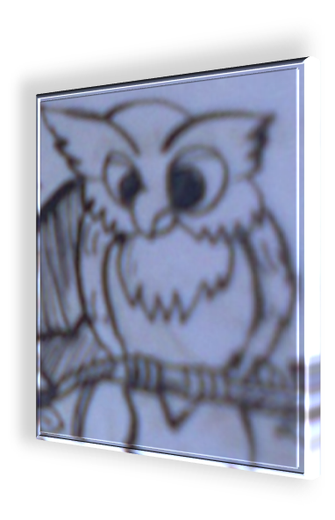
Host
entertainer, owner, person of the house
*a person who receives or entertains guests, esp. in his own home (textual)

Slide 14
Grateful
thankful, indebted, pleased (textual )

Slide 15
Group Work: look at the picture and describe the situation
The dove lifted her head slowly and said,
As the owl eagerly wanted to hear some admiring utterance from the dove, in this situation, the truthful dove raising its head slowly,
expressed its gratitude to the owl because it had given it the shelter and food at the time of danger.
“Master owl, thank you
very much for the shelter you have given me, thank you for the food you have offered me . I will remain ever grateful for this.”

Slide 16
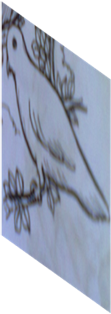
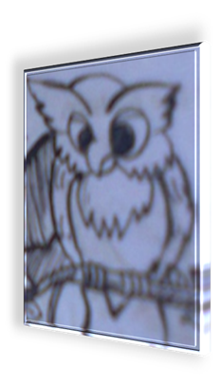
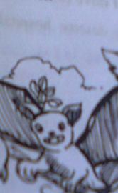
Individual Work:
Answer the following questions
1.What does the word ‘insincere’ mean in the story?
2.Why did the dove think that the bat is insincere?
3.What made the owl impatient?
4.Why was the dove ashamed of her friend?

Slide 17
Individual Work: True or false?
If false, give the correct information.
The bat was very sincere when he praised the owl.
The owl wanted to hear some good things about himself.
The dove was very harsh to the owl.
***The learners will be asked for writing the answers on the board.

Slide 18
Home work
In the light of the text ,write a paragraph on
“ Gratefulness “

Slide 19
THANK YOU VERY MUCH
THANK YOU VERY MUCH

